Slide 1
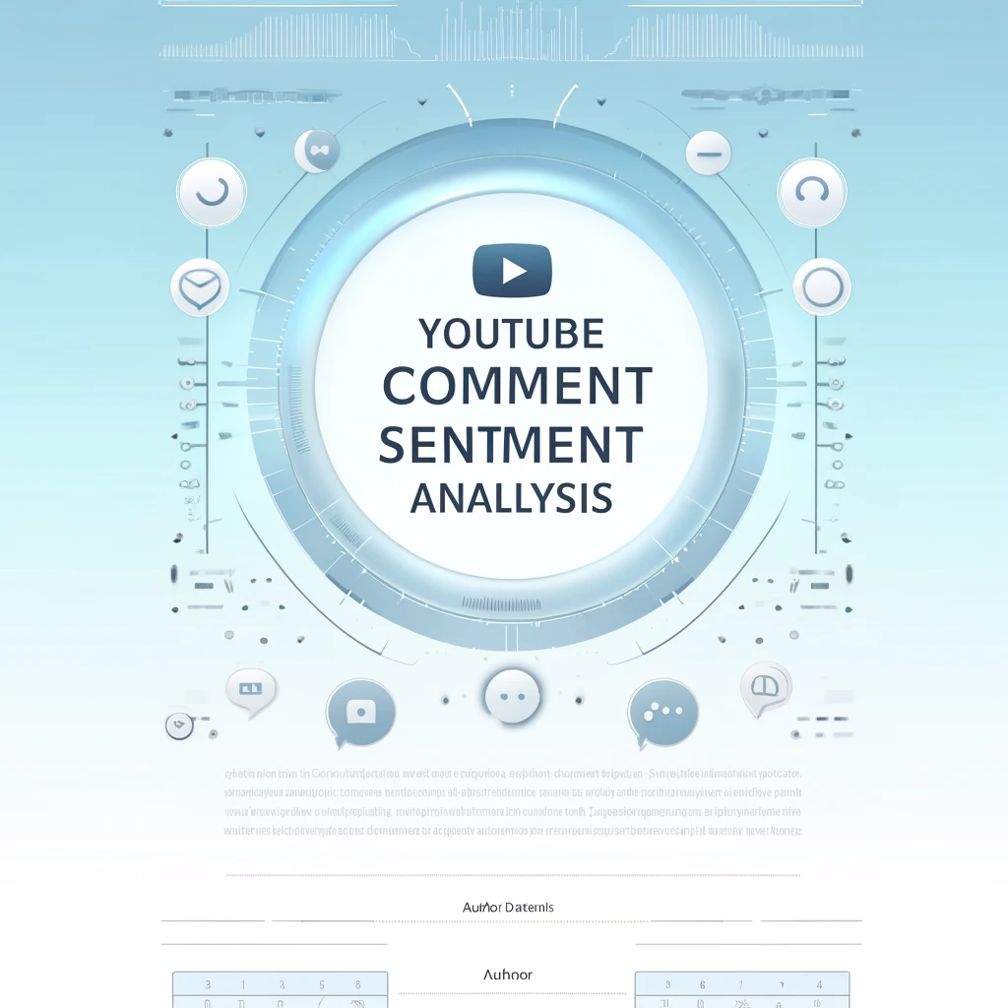
Mossran Thamid khan 1821117042
Nowshin Nawal Mim 1911054042

Slide 2
About our project
Our project aims to perform sentiment analysis on Youtube videos comments using machine learning techniques. With the exponential growth of YouTube as a platform for content consumption, analyzing user comments becomes crucial for content creators, marketers, and researchers to understand audience sentiment, engagement, and preferences . In this project our main goal is to make an attempt to determine the sentiment of youtube videos comments ( Weather it positive or negative or neutral) to understand audience reactions to videos.

Slide 3
Work plan
Data Collection: Gather diverse datasets of YouTube comments across different channels and genres.
Preprocessing: Clean and preprocess the comments data to remove noise and irrelevant information.
Feature Extraction: Extract relevant features such as text embeddings and sentiment scores.
Model Training: Train machine learning models (e.g., NLP models, sentiment classifiers)
Model Evaluation: Evaluate model performance using accuracy, precision, recall, and F1-score.
Deployment: Develop a user-friendly interface for creators to input video URLs and receive insights.

Slide 4





Project Walkthrough
Collect data set
Data pre processing
Train Test split
Train the model
web application
New Data
Trained model

Slide 5
Dataset,model and feature
600K dataset (Data set collect from Kaggle )
Features :Provide sentiment results with associated emojis (😊 for positive, 😞 for negative, 😐 for neutral). Visualization of sentiment distribution .
We will use Three model :
RNN (Recurrent Neural Network)
LSTM (Long Short-Term Memory)
GRU (Gated Recurrent Unit)
GRU (Gated Recurrent Unit), LSTM (Long Short-Term Memory), and RNN (Recurrent Neural Network) are architectures used in deep learning, a subset of machine learning. They are specifically designed for handling sequential or time-series data.

Slide 6
Tools & Technologies for Sentiment Analysis
Programming Languages:
Python (libraries: Scikit-learn, NLTK, Torch,Cloudword,spacy)
Data Preprocessing Tools:
Pandas, NumPy, and regular expressions for cleaning and formatting data
Model :
RNN
Annotation Tools:
Manual or semi-automated tools for creating labeled datasets
Visualization:
Matplotlib and Seaborn for presenting trends and results
Development Environment:
Google Colab

Slide 7
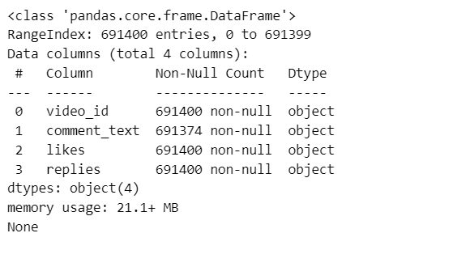
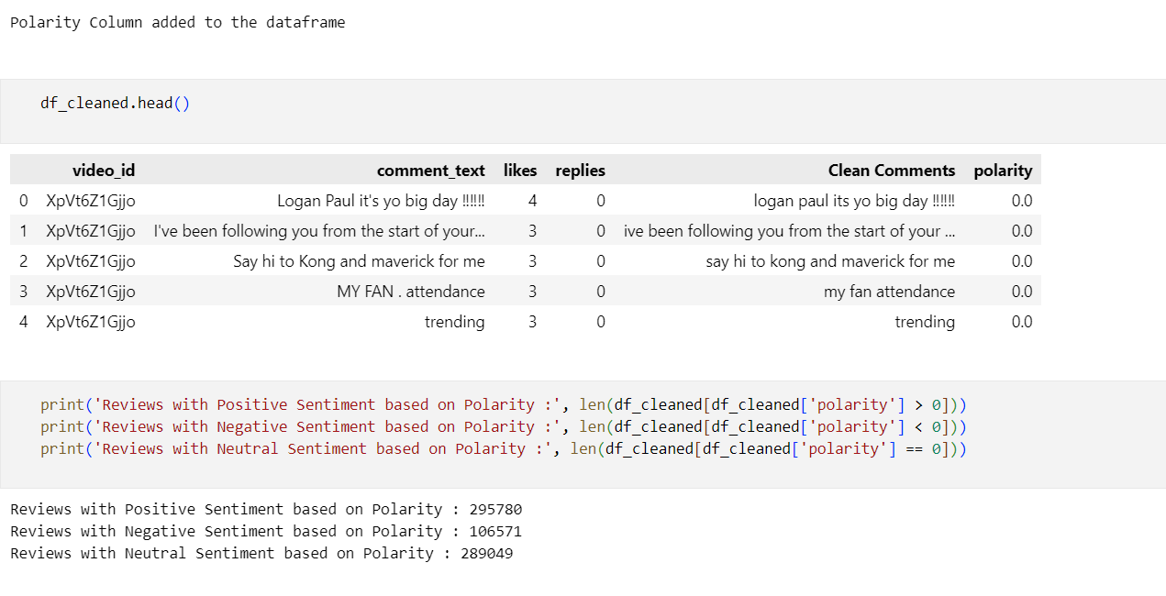
Data analysis and Preprocessing
Data Collection: YouTube API.
Text Cleaning: Remove noise, special characters, URLs, and stopwords.
Tokenization: Split comments into words.
Text Normalization: Lemmatize or Stem words.
Text Representation: Word Embeddings.
Label Encoding: Convert sentiments (positive, neutral, negative) to numerical labels.
Split Dataset: Train-Test split for model training.

Slide 8
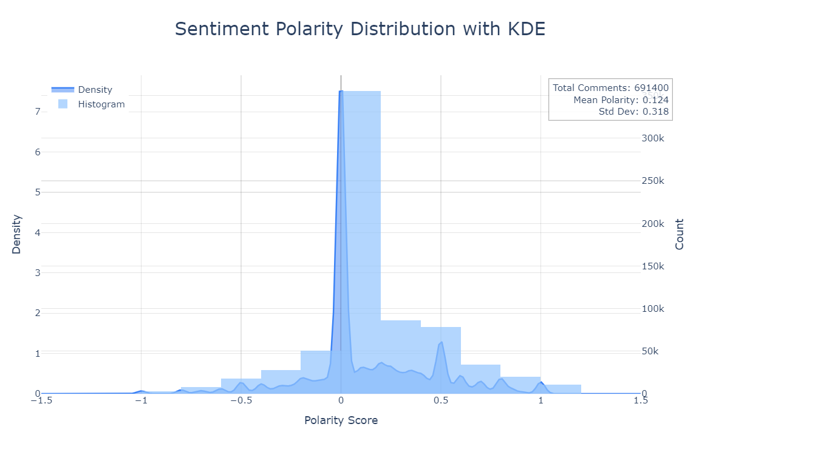
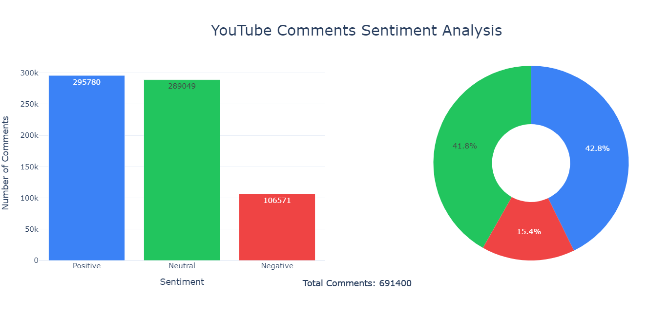
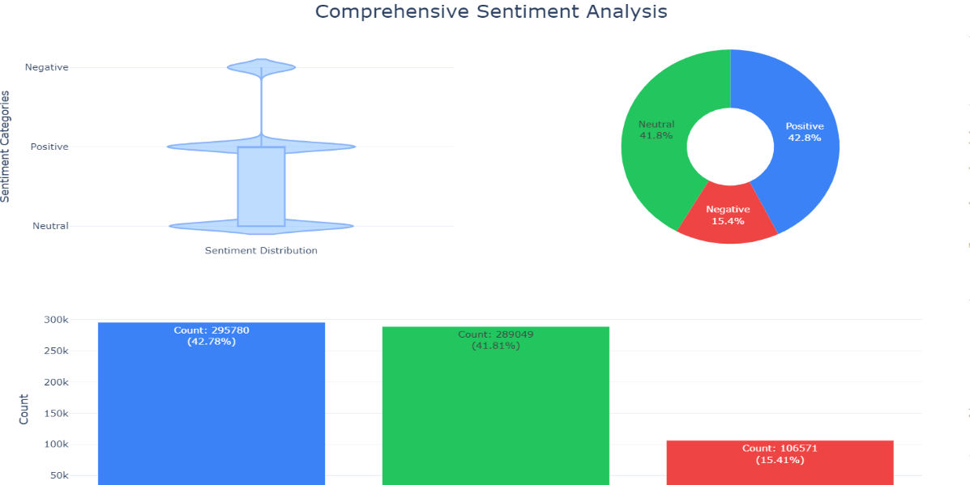
Data visualization

Slide 9
Model implement(Rnn)
we implement Recurrent Neural Network (RNN) to classify sentiment (e.g., positive, negative, neutral) in text data. The architecture is tailored for text classification and includes features like embedding layers, bidirectional RNNs, and regularization.
RNN Architecture for Sentiment Analysis
Input | → Embedding Layer | → RNN Layer | → Hidden State | → Fully Connected Layer | → Output
Text Data | Word Vectors | Sequential Processing | Context Summary | Sentiment Prediction | Positive/Negative
RNN Workflow
Input Sequence → "I love this movie"
Embedding Layer → Dense vectors
RNN Layer → Sequentially processes embeddings, updating hidden states.
Hidden State → Summarizes information from the sequence.
Output Layer → Sentiment prediction (positive/negative).

Slide 10
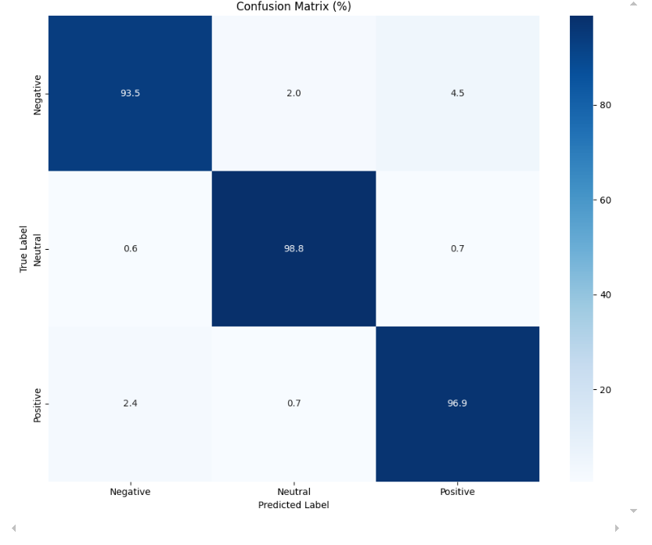
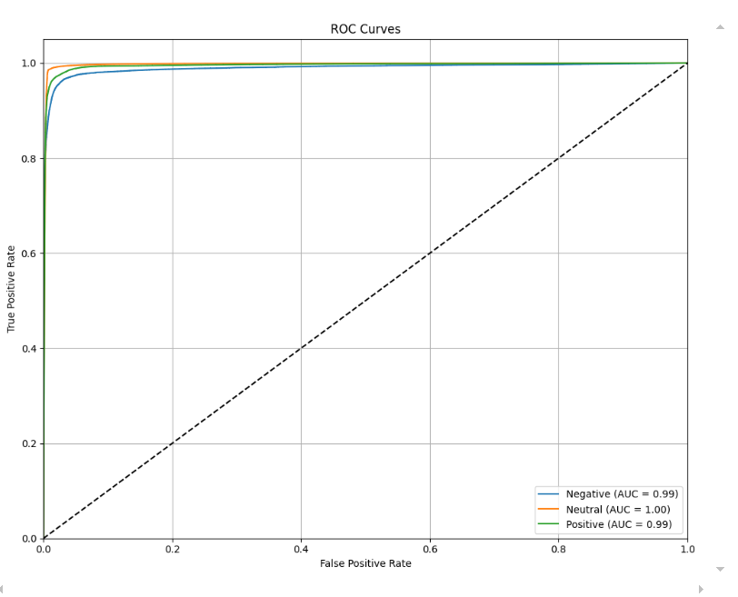
Result

Slide 11
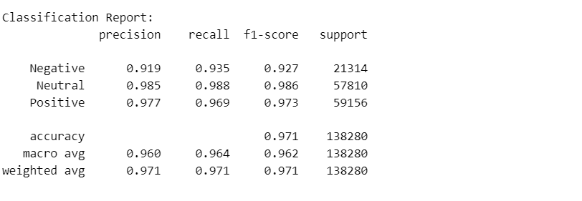
result

Slide 12
Impact of YouTube Comment Sentiment Analysis
Economic:
Helps businesses identify trends in customer feedback for marketing and product improvement.
Cost-effective way to analyze public sentiment without extensive surveys.
Social:
nables understanding of public opinion on trending topics.
Enhances engagement and awareness within online communities.
Political:
Identifies public sentiment on political campaigns and events.
Monitors misinformation or polarization in social discussions.
Health:
Tracks sentiment on health-related topics, such as public reaction to pandemics or medical campaigns.
Analyzes mental health indicators based on user comments.

Slide 13
Ethical & Professional Considerations
Data Privacy:
Ensuring user comments are collected and analyzed responsibly without violating privacy.
Bias Management:
Avoiding algorithmic bias to ensure fair and accurate sentiment classification.
Transparency:
Clearly explaining methods and limitations of the analysis to stakeholders.
Professional Integrity:
Using sentiment insights responsibly without manipulating public opinion or promoting misinformation

